Slide 1
Optimizing Investment Casting for Super Alloys – A Ripple Effect Improvements in Service Life of Ceramic Melt Containers and Effects on Sustainability
32nd EICF Conference & Exhibition
Città della Scienza | Napoli (Italy)
May 12th-15th, 2024

Slide 2
Presentation Outline
Zircoa
Overview of relevant standards
Case study
Focus on sustainability
Zirconia as crucible material
Best practice and sustainability
Conclusions

Slide 3
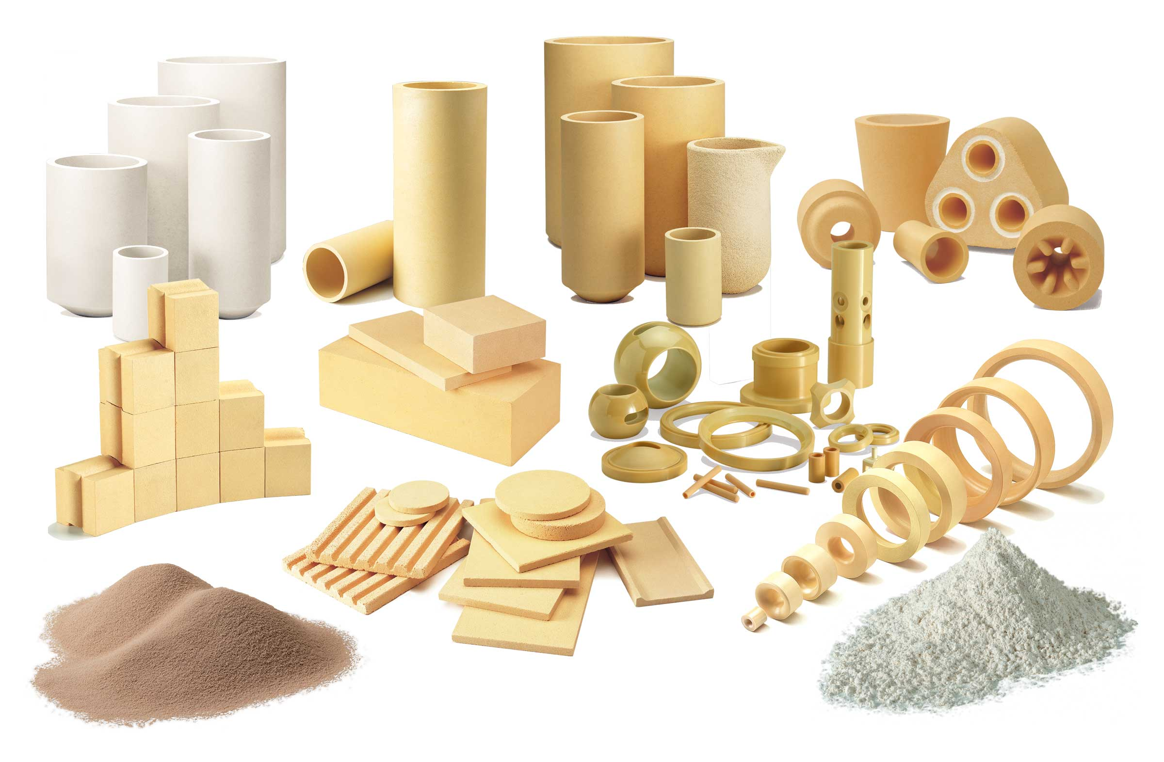
Zircoa
Zircoa, Inc., USA
Headquarters
Founded 1952
ISO 9001:2015 with Design
Zircoa GmbH, Germany
Sales office EMEA
Founded 2012
100% Subsidiary of Zircoa, Inc.

Slide 4
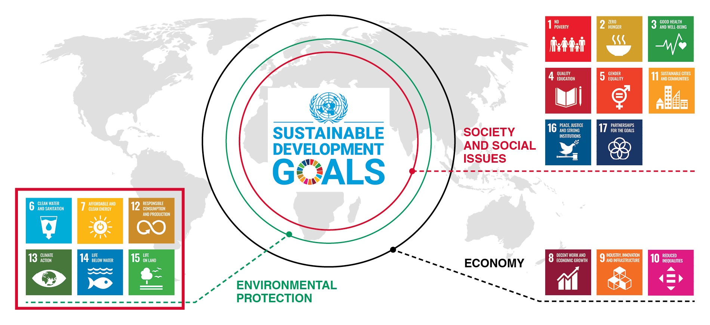
UN Sustainable Development Goals (SDG)
UN Agenda 2030, from 2015
17 Sustainable Development Goals (SDG)
169 Targets to be achieved by 2030
Source: https://www.perlon.com/en/sustainability/

Slide 5


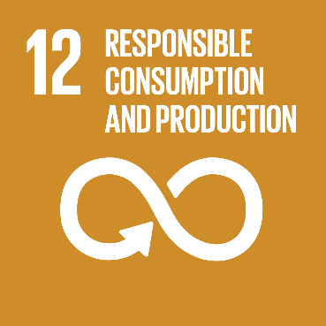
UN Sustainable Development Goals (SDG)
Target 8.4
IMPROVE RESOURCE EFFICIENCY IN CONSUMPTION AND PRODUCTION
Target 9.5
ENHANCE RESEARCH AND UPGRADE INDUSTRIAL TECHNOLOGIES
Target 12.2
SUSTAINABLE MANAGEMENT AND USE OF NATURAL RESOURCES
Target 12.4
RESPONSIBLE MANAGEMENT OF CHEMICALS AND WASTE
Target 12.5
SUBSTANTIALLY REDUCE WASTE GENERATION
Source: https://www.globalgoals.org

Slide 6
Overview of Relevant Standards
Sustainability in Investment Casting (IC):
Focus on reducing environmental impact, optimizing resource utilization, and ensuring ethical practices throughout the manufacturing process
What do these contain?
Resource efficiency (raw materials / water management)
Reduced emissions (raw material and final part production)
Supply chain transparency
Life cycled assesment / Continuous improvement
What are the measures?
Specific metric-based with various ISO certifications upon meeting
Who is already certified?
Continual push for raw material and final part manufactures to adopt sustainability standarads

Slide 7
Overview of Relevant Standards
ISO 14001: Environmental management systems
Systematic approach for organization to develop an Environmental Management System (EMS) and continually improve their environmental performance/impact.
Follows a Plan-Do-Check-Act (PDCA) cycle for contiunous environmental improvement
ISO 14040 & 14044: Life Cycle Assesment (LCA)
Standardized assement method to compare environmental performance and impact of various products and services
ISO 50001: Energy management systems
Framework for organizations to establish, implement, maintain, and improve an energy management system (EnMS)
Effort to improve manufacture’s energy performance, reduce energy costs, and demonstrate a commitment to sustainable energy management practices

Slide 8
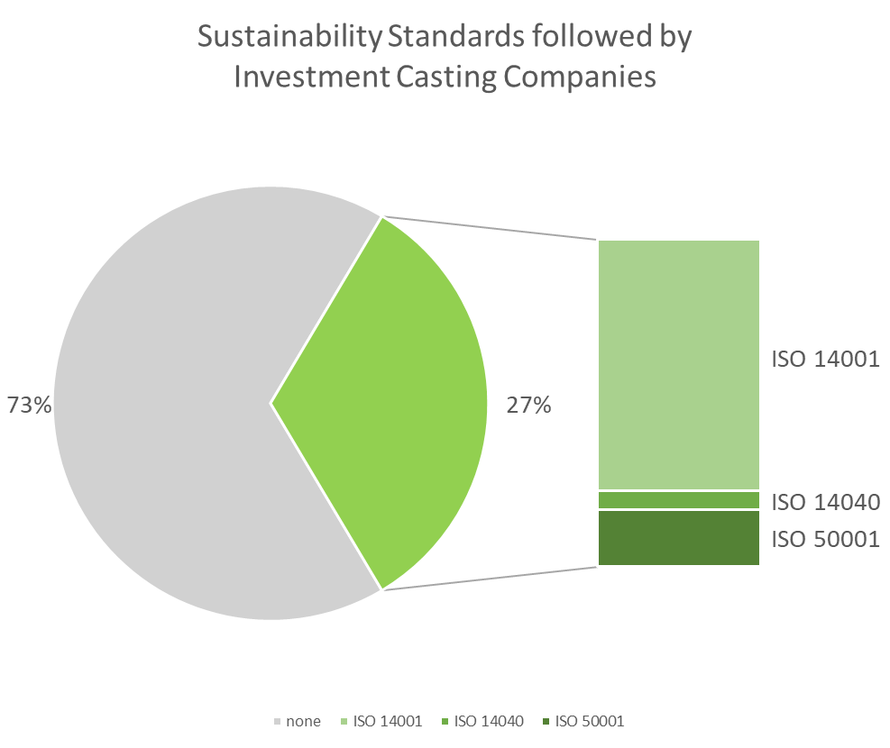
Sustainability Standards in Investment Casting Industry
Review of 146 investment casting company websites¹
Standards followed:
ISO 14001: 27 %
ISO 14040: 2 %
ISO 50001: 8 %
+25 % of reviewed companies follow one or more of the above mentioned sustainability standards
¹ INCAST magazine - Buyers Guide Group / Foundry Issue (Oct 2023, Vol. XXXVI, No10)

Slide 9
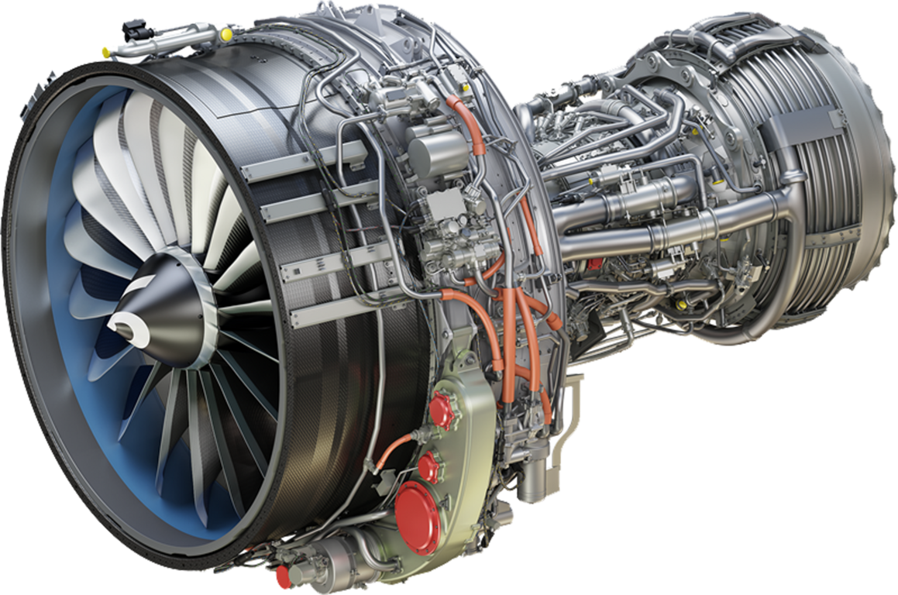
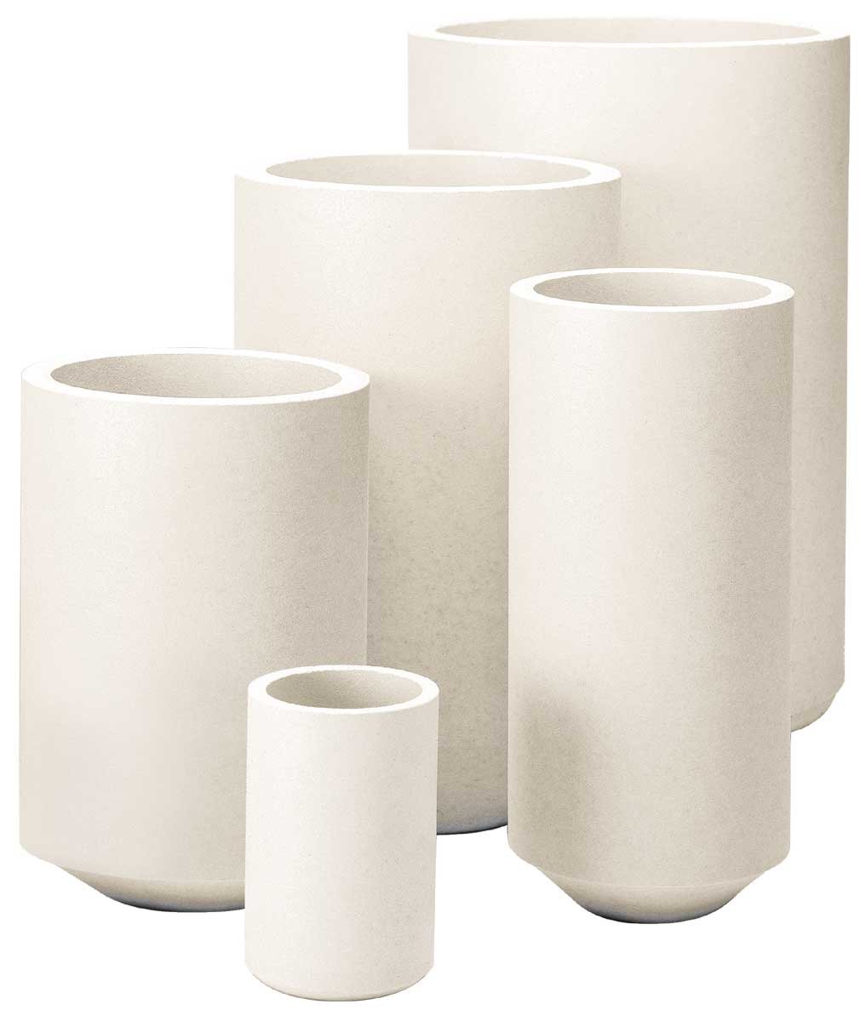
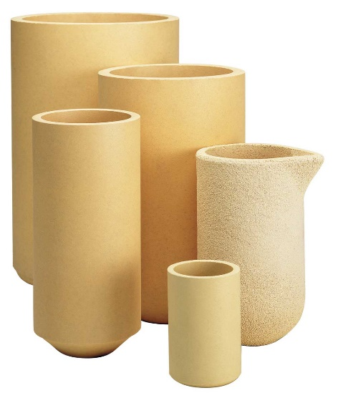
Case Study - Introduction
Vacuum investment casting of nickel-base superalloy turbine blades for aerospace/IGT applications….
…to be cast in a melt container,
either liner or crucible
Source: https://www.mtu.de

Slide 10
Case Study - Comparison of Melt Containers
 | Liner | Crucible
Number of melts | 1 | 15-50
Price per unit | Low | High
Price per casting | Break even ~15 melts
Logistics | High volume | Low volume
Erosion resistance | Low | High
Thermal Shock resistance | High | Low-medium
Preparation time | Fast | Slow
Casting operation time | Medium | Fast
Flexibility | High | Medium
Casting suitability:
Equiax | Good | Very good
Directional Solidification | Good | Medium
Single Crystal | Good | Medium
 | Liner | Crucible
Number of melts | 1 | 15-50
Price per unit | Low | High
Price per casting | Break even ~15 melts
Logistics | High volume | Low volume
Erosion resistance | Low | High
Thermal Shock resistance | High | Low-medium
Preparation time | Fast | Slow
Casting operation time | Medium | Fast
Flexibility | High | Medium
Casting suitability:
Equiax | Good | Very good
Directional Solidification | Good | Medium
Single Crystal | Good | Medium

Slide 11
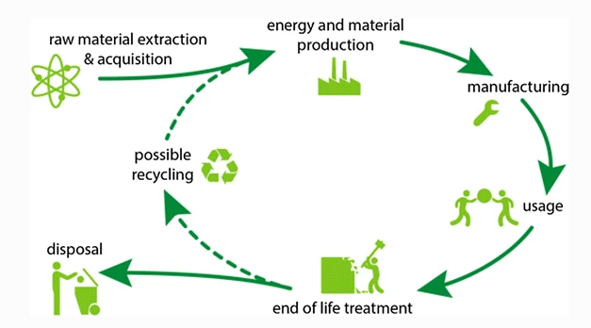
Sustainability Focus - Circular Economy
Waste Hierarchy
Most preferred
Prevention
Recycling
Preparation for re-use
Recovery
Disposal
Least preferred
Source: Farrelly D (1984) The book of bamboo

Slide 12

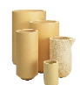
Sustainability Focus - Life Cycle Comparison
Melt Container Production | Liner | Crucible | Comments / Assumptions
density (g/cm³) | 2,4 | 4,4 | Alumina-silicate liner vs. Zirconia crucible
≈14kg melt container (kg) | 2,9 | 5,5
Mass of material for 20 melts (kg) | 58 | 5,5 | Assume crucible can achieve 20 melts per crucible
CO₂ for RM production (kg) | 47,9 | 2,2 | Liner (calcined Al₂O₃ / mined SiO₂), Crucible (mined ZrO₂)
CO₂ for melt container production (kg), 20 melts | 16,4 | 1,5 | Firing at 1200°C for liner and 1700°C for crucible (2,0kg CO₂ for every m³ of Natural gas burned)
Packaging & Delivery
Liners/Crucibles per pallet | 144 | 18 | Liners can be packed more economically, (1200 x 800)mm pallet size
Cost to ship liners / crucibles for 20 melts (€) | 33,3 | 13,3 | Assume 240€ per pallet for delivery
Transport / Storage volume for 20 melts (m³) | 0,13 | 0,05 | Assuming 0,96m³ per pallet
CO₂ Emission for product transport (kg) | 49 | 19 | Assuming 500km distance (consumption: 30l/km, emission 2,5kg/l) →1m³ volume
Waste
Mass of material for 20 melts (kg) | 58 | 5,5
Cost of disposal (€) | 2,3 | 0,2 | Assuming 0,04€/kg
Cost to transport to disposal (€) | 1,7 | 0,7 | 5% cost to transport to dump vs. part delivery
CO₂ Emission for waste transport (kg) | 51 | 20 | Assuming 500km distance (consumption: 30l/km, emission 2,63kg/l) →1m³ volume
Summary
Estimated Total Cost for 20 melts (€) | 37 | 14
Estimated Total CO₂ emissions for 20 melts (kg) | 164 | 42
Melt Container Production | Liner | Crucible | Comments / Assumptions
density (g/cm³) | 2,4 | 4,4 | Alumina-silicate liner vs. Zirconia crucible
≈14kg melt container (kg) | 2,9 | 5,5
Mass of material for 20 melts (kg) | 58 | 5,5 | Assume crucible can achieve 20 melts per crucible
CO₂ for RM production (kg) | 47,9 | 2,2 | Liner (calcined Al₂O₃ / mined SiO₂), Crucible (mined ZrO₂)
CO₂ for melt container production (kg), 20 melts | 16,4 | 1,5 | Firing at 1200°C for liner and 1700°C for crucible (2,0kg CO₂ for every m³ of Natural gas burned)
Packaging & Delivery
Liners/Crucibles per pallet | 144 | 18 | Liners can be packed more economically, (1200 x 800)mm pallet size
Cost to ship liners / crucibles for 20 melts (€) | 33,3 | 13,3 | Assume 240€ per pallet for delivery
Transport / Storage volume for 20 melts (m³) | 0,13 | 0,05 | Assuming 0,96m³ per pallet
CO₂ Emission for product transport (kg) | 49 | 19 | Assuming 500km distance (consumption: 30l/km, emission 2,5kg/l) →1m³ volume
Waste
Mass of material for 20 melts (kg) | 58 | 5,5
Cost of disposal (€) | 2,3 | 0,2 | Assuming 0,04€/kg
Cost to transport to disposal (€) | 1,7 | 0,7 | 5% cost to transport to dump vs. part delivery
CO₂ Emission for waste transport (kg) | 51 | 20 | Assuming 500km distance (consumption: 30l/km, emission 2,63kg/l) →1m³ volume
Summary
Estimated Total Cost for 20 melts (€) | 37 | 14
Estimated Total CO₂ emissions for 20 melts (kg) | 164 | 42
Liner
Crucible

Slide 13
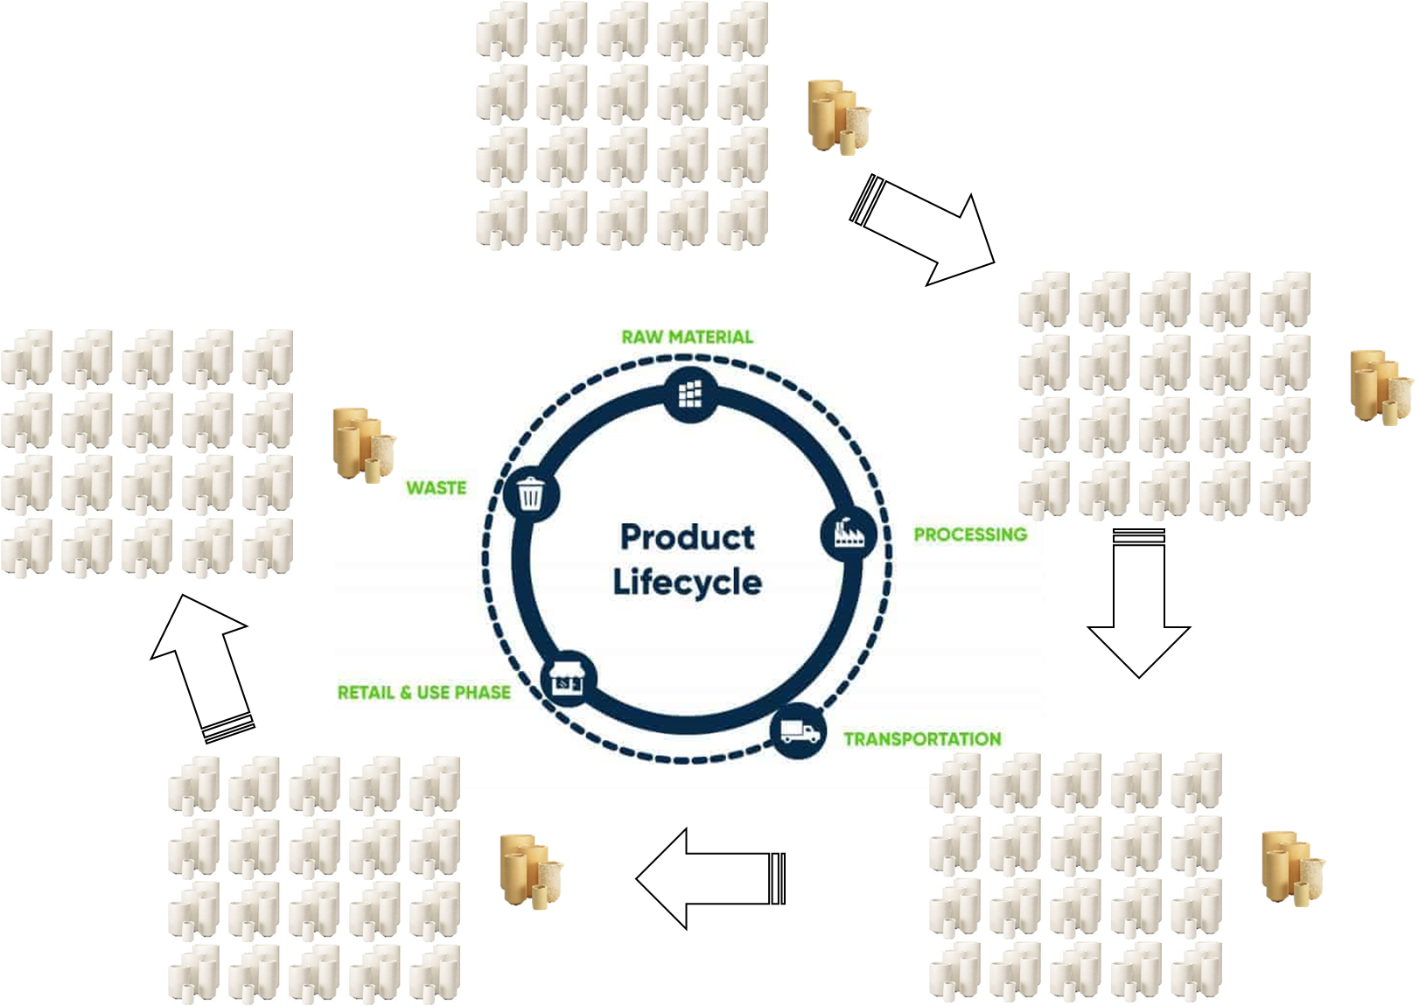
Sustainability Focus - Life Cycle Comparison
Depending on the ratio of the maximum number of melts, the waste/disposal when crucibles can be used is 15-50 times less compared to liners.
Significant effect on volume of used material/disposal
Source: https://ecochain.com

Slide 14
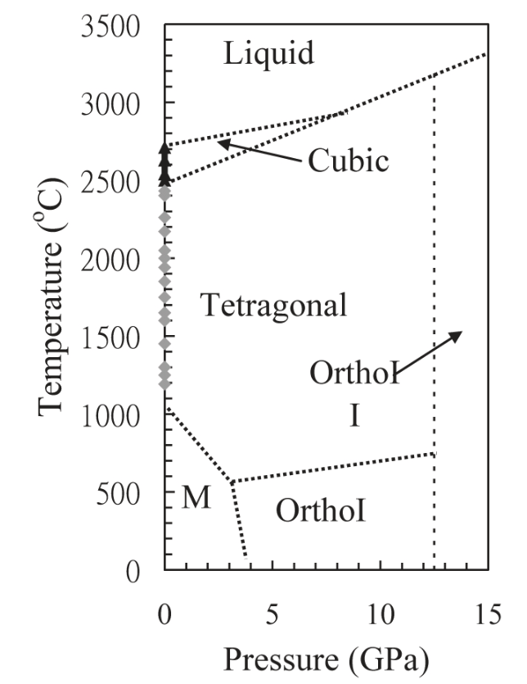
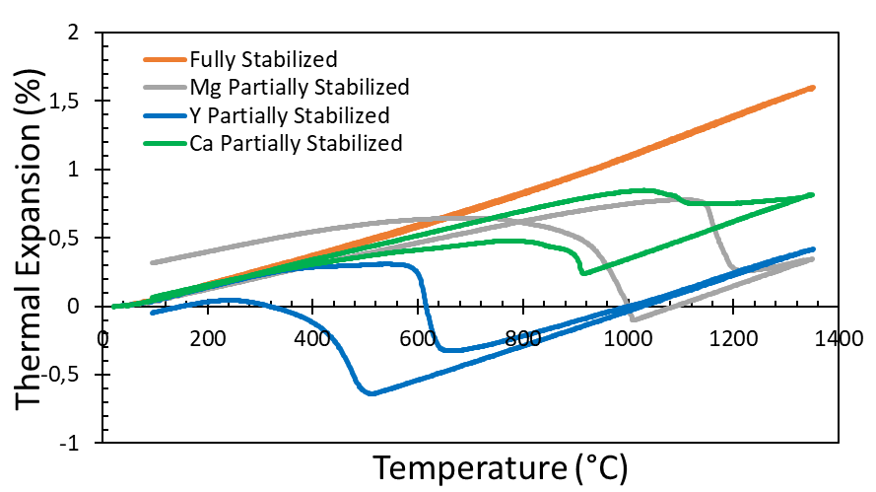
Zirconia as Crucible Material
What is zirconia?
Zirconium Oxide (ZrO₂)
High melting temperature (2715 °C)
Phase Transition
Stabilizers
Ca, Mg, Y, Ce
Used to control phase transition and thermal expansion
Source: Shackelford, J. F., & Doremus, R. H. (Eds.). (2008). Ceramic and Glass Materials.

Slide 15
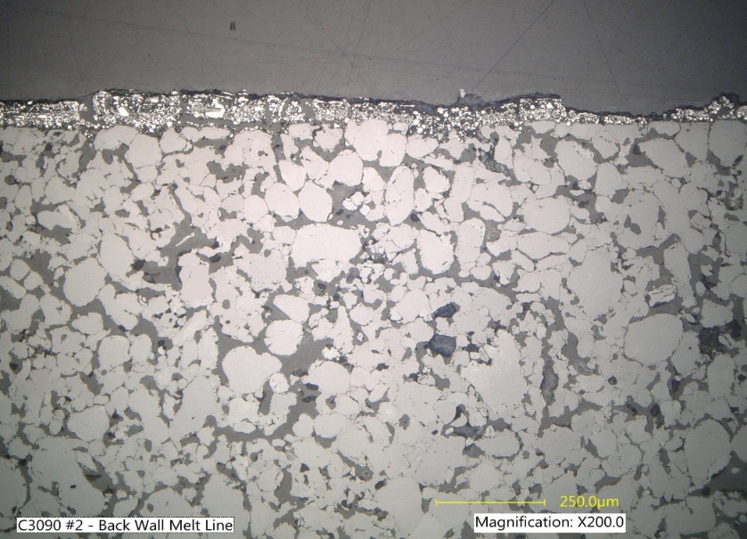
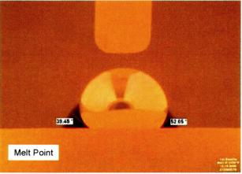
Zirconia as Crucible Material - Typical Use
Common alloys
Nickel based superalloy
Cobalt based superalloy
Low thermal conductivity
High resistance
Wetting Angle
Zirconia has a high wetting angle with many Ni- and Co-based superalloys
Low Reactivity
Erosion corrosion resistant
Drop some post mortem crucible microstructures and crucible finish pictures here

Slide 16
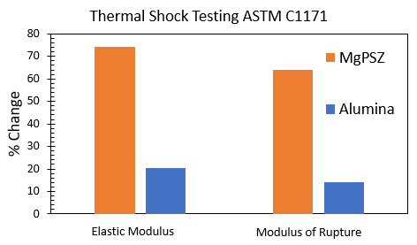
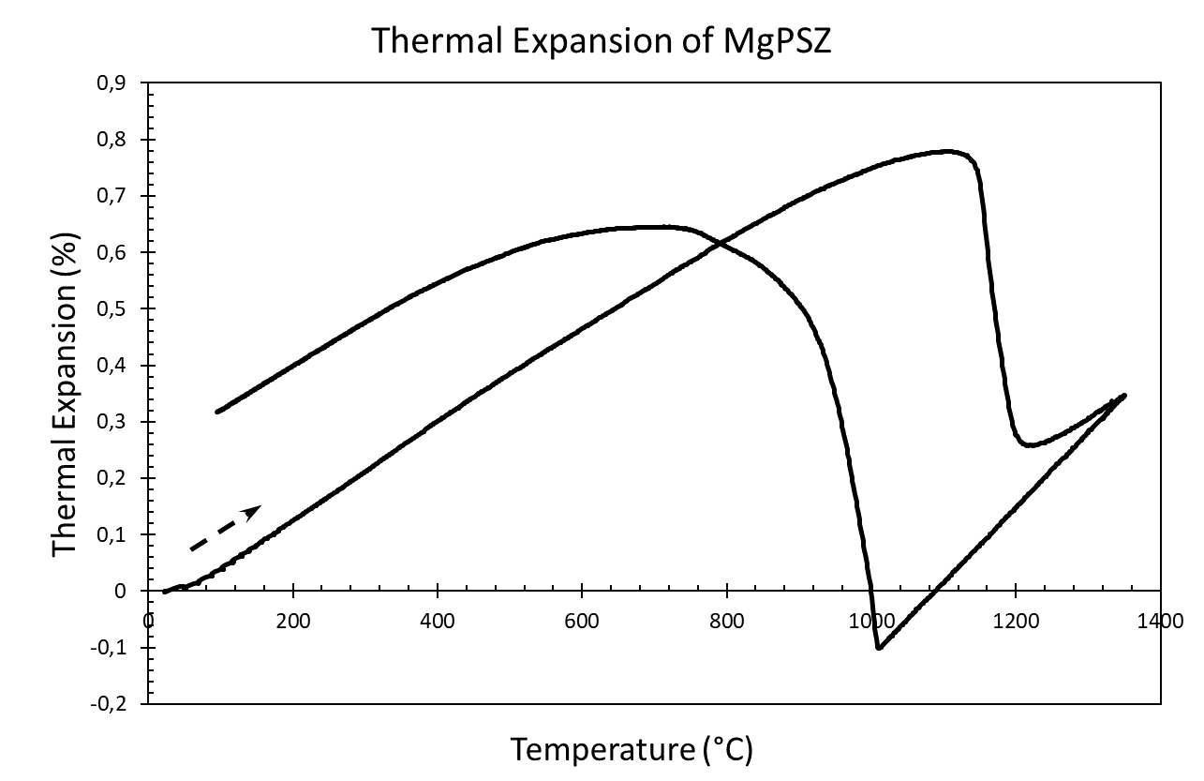
Zirconia as Crucible Material - Key Considerations
Thermal Shock
Biggest limitation
High thermal expansion compared to other common oxides
Phase transition and thermal stress
Sensitive in thermal handling
Improper thermal cycling leads to microstructure weakening
Cost
Zirconia is typically more expensive than other refractory materials

Slide 17
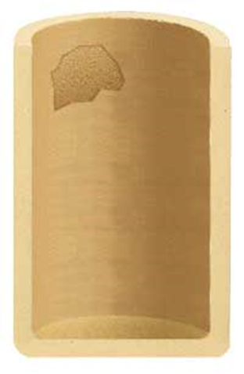
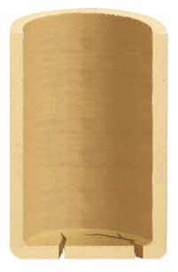
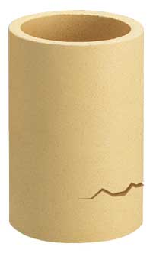
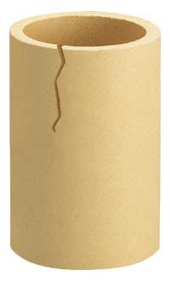
Zirconia as Crucible Material - Types of Failures
Large “spalls” on the inner sidewalls | Inside bottom cracks | Horizontal cracks | Vertical cracks
Possible causes Billet striking crucible wall during charging Extreme thermal shock | Possible causes Billet striking crucible bottom during charging The lack of proper bottom support at temperature Crucible allowed to cool excessively between pours Incorrect type of backup material Not enough backup material | Possible causes Non-uniform heating or cooling of the crucible Too rapid heating during initial preheat cycle Insufficient backup support near bottom of crucible | Possible causes Lack of adequate or proper backup material Ineffective insulation near the top of the crucible Excessive thermal cycling of pour lip

Slide 18
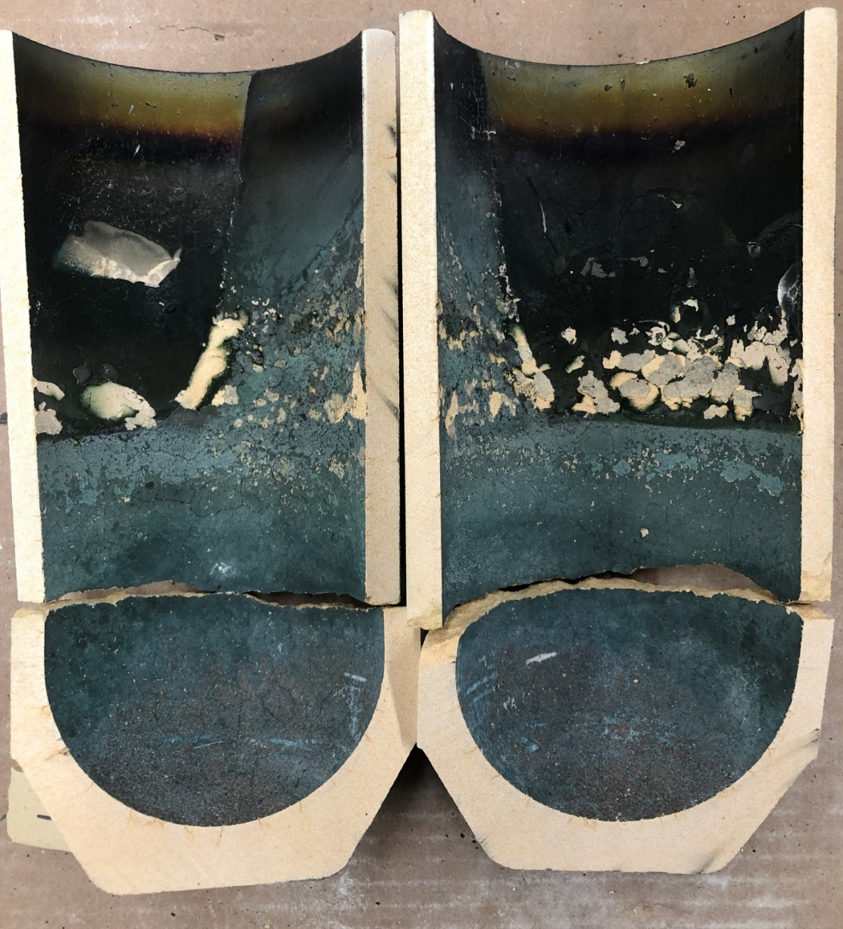
Zirconia as Crucible Material - Typical Failure Modes
Mechanical damage
Damage due to loading of metal ingots
Crucible not properly supported
Thermal cycling
Rapid heating and/or cooling through transition temperatures could impact mechanical integrity
Lack of proper temperature management
Uneven heat distribution leads to phase transition induced strain
Pour path is not pre-heated leading to cracks along the path

Slide 19
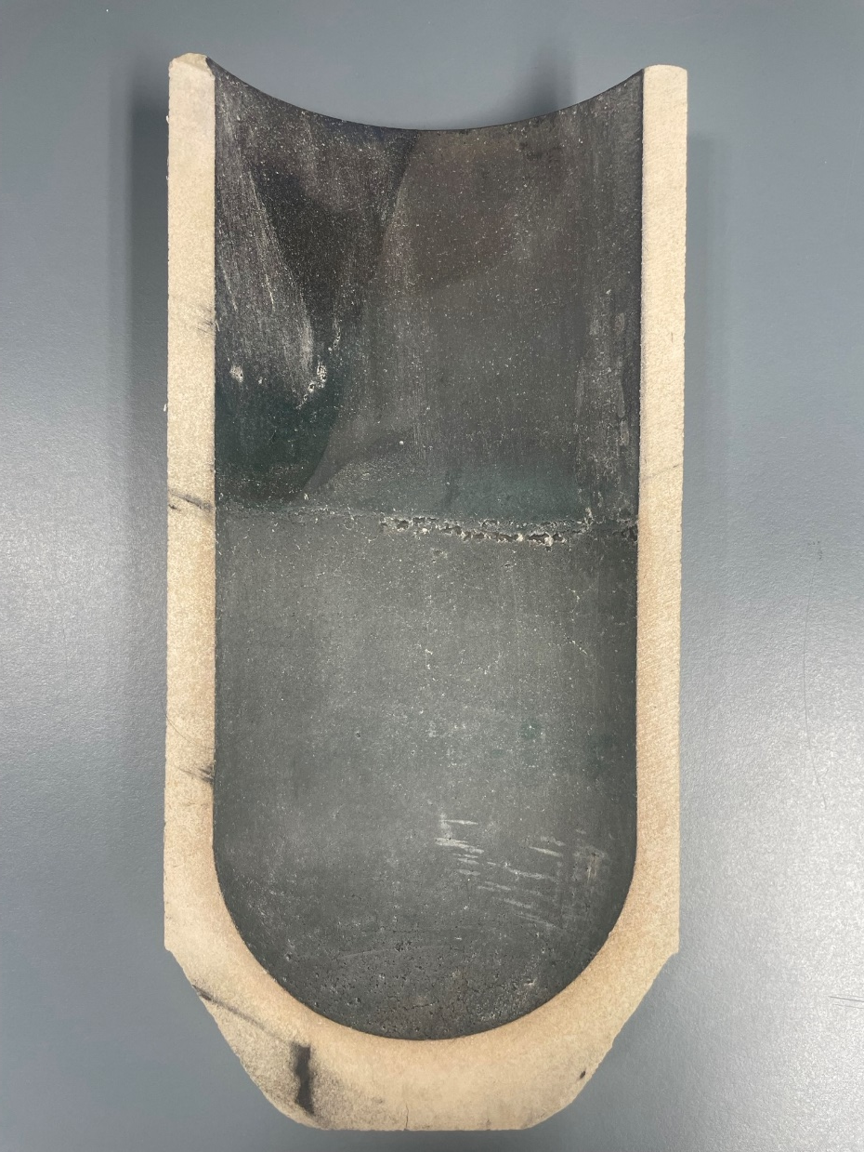
Zirconia as Crucible Material - Successful Optimization
Beneficial
Proper installation
Sensitive handling / prevention of mechnical stress
Considering phase transition related change of volume
Consistant casting operation
Detrimental
Extreme temperature gradients
Quick temperature changes
Inconsistant processes

Slide 20
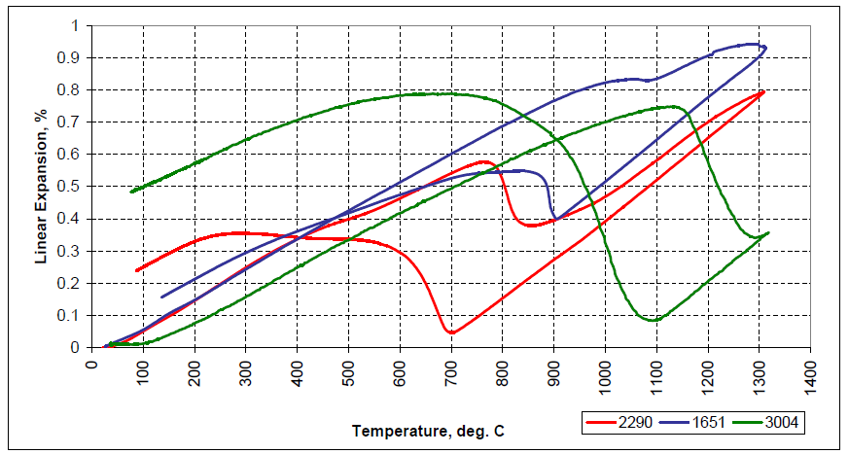
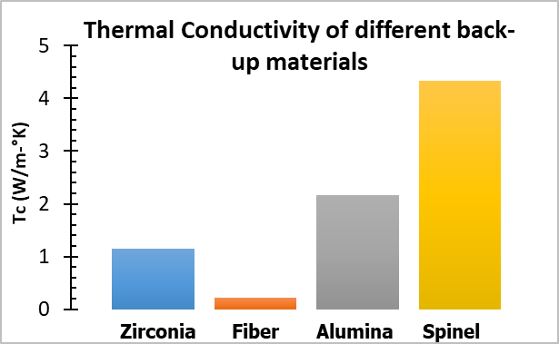
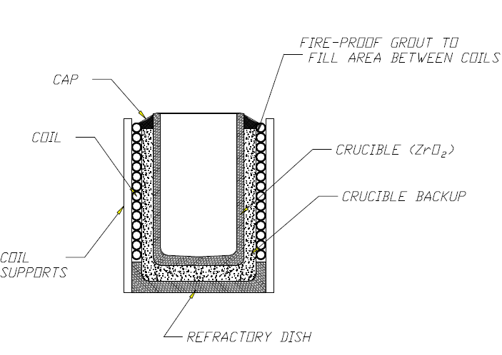
Zirconia as Crucible Material - Training and Technical Support
Zircoa engineering guide
Best-practice in using crucibles
Casters Training Workshop
Practical
Training with the casting operation team
Best practices for crucible installation and casting operation
Discussion of typical situations and potential causes of failure
Theoretical
Technical presentation
Improved sustainability through process optimization

Slide 21
Conclusions
Growing acknowledgement and adoption of sustainable investment casting practices
Currently sustainability standards followed by +25% of reviewed group
Case study: Opportunities for energy and waste reduction
Multi use crucibles as a sustainable choice
Recycling aspect
Best practices and training to realize full potential
Automation in support of sustainability initiatives
Ripple effect:
Bridging the knowledge gap on the optimal use of crucibles opens up the opportunity of significant waste reduction

Slide 22
Deliver What Matters

