Slide 1
Resilient Supply Chains: Market-Proven Concepts for the Investment Casting Industry
33rd EICF Conference & Exhibition
ACC Liverpool
5 to 8 of May 2025
Tobias Schmidt
Sales Engineer
Zircoa GmbH

Slide 2
Outline
Zircoa
Supply Chain
Disruptions
Survey
Observations in Best-Practice
Key Take-Aways

Slide 3
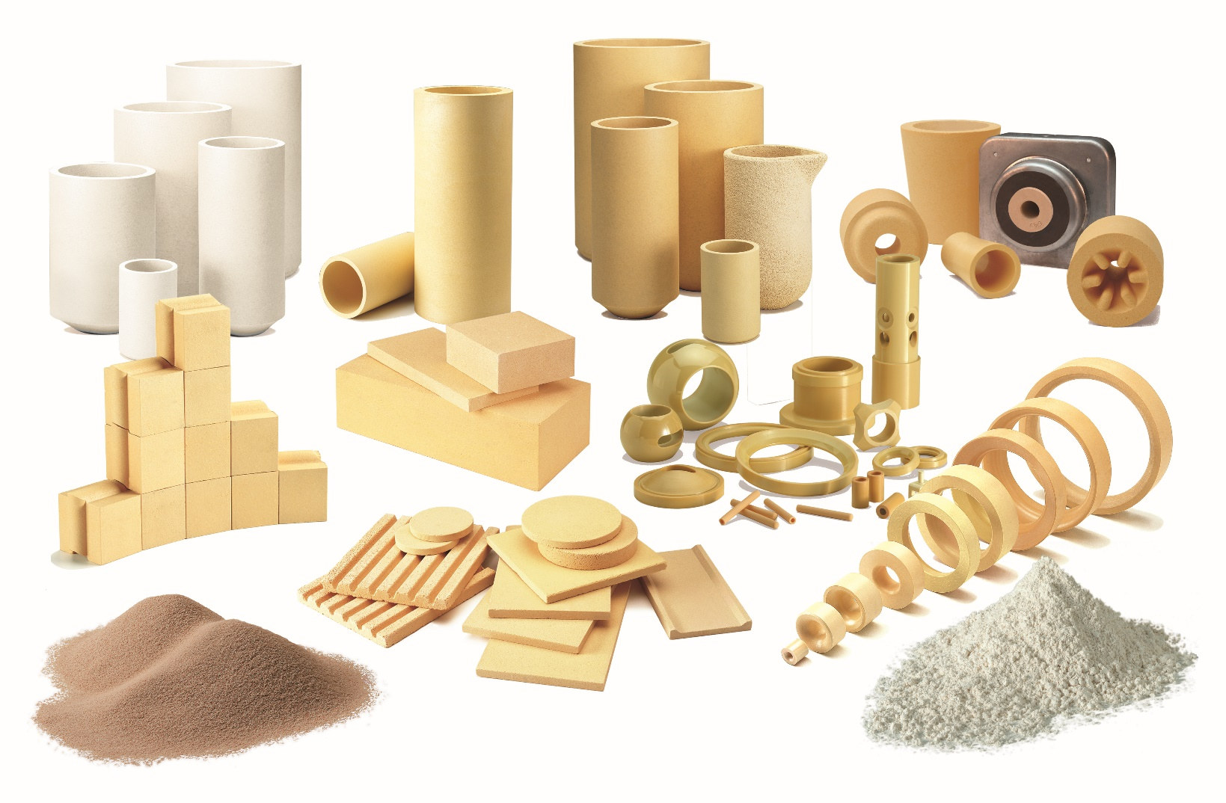
Zircoa
Zircoa, Inc., USA
Headquarters
Founded 1952
ISO 9001:2015 with Design
Zircoa GmbH, Germany
Sales office EMEA
Founded 2012
100% Subsidiary of Zircoa, Inc.

Slide 4
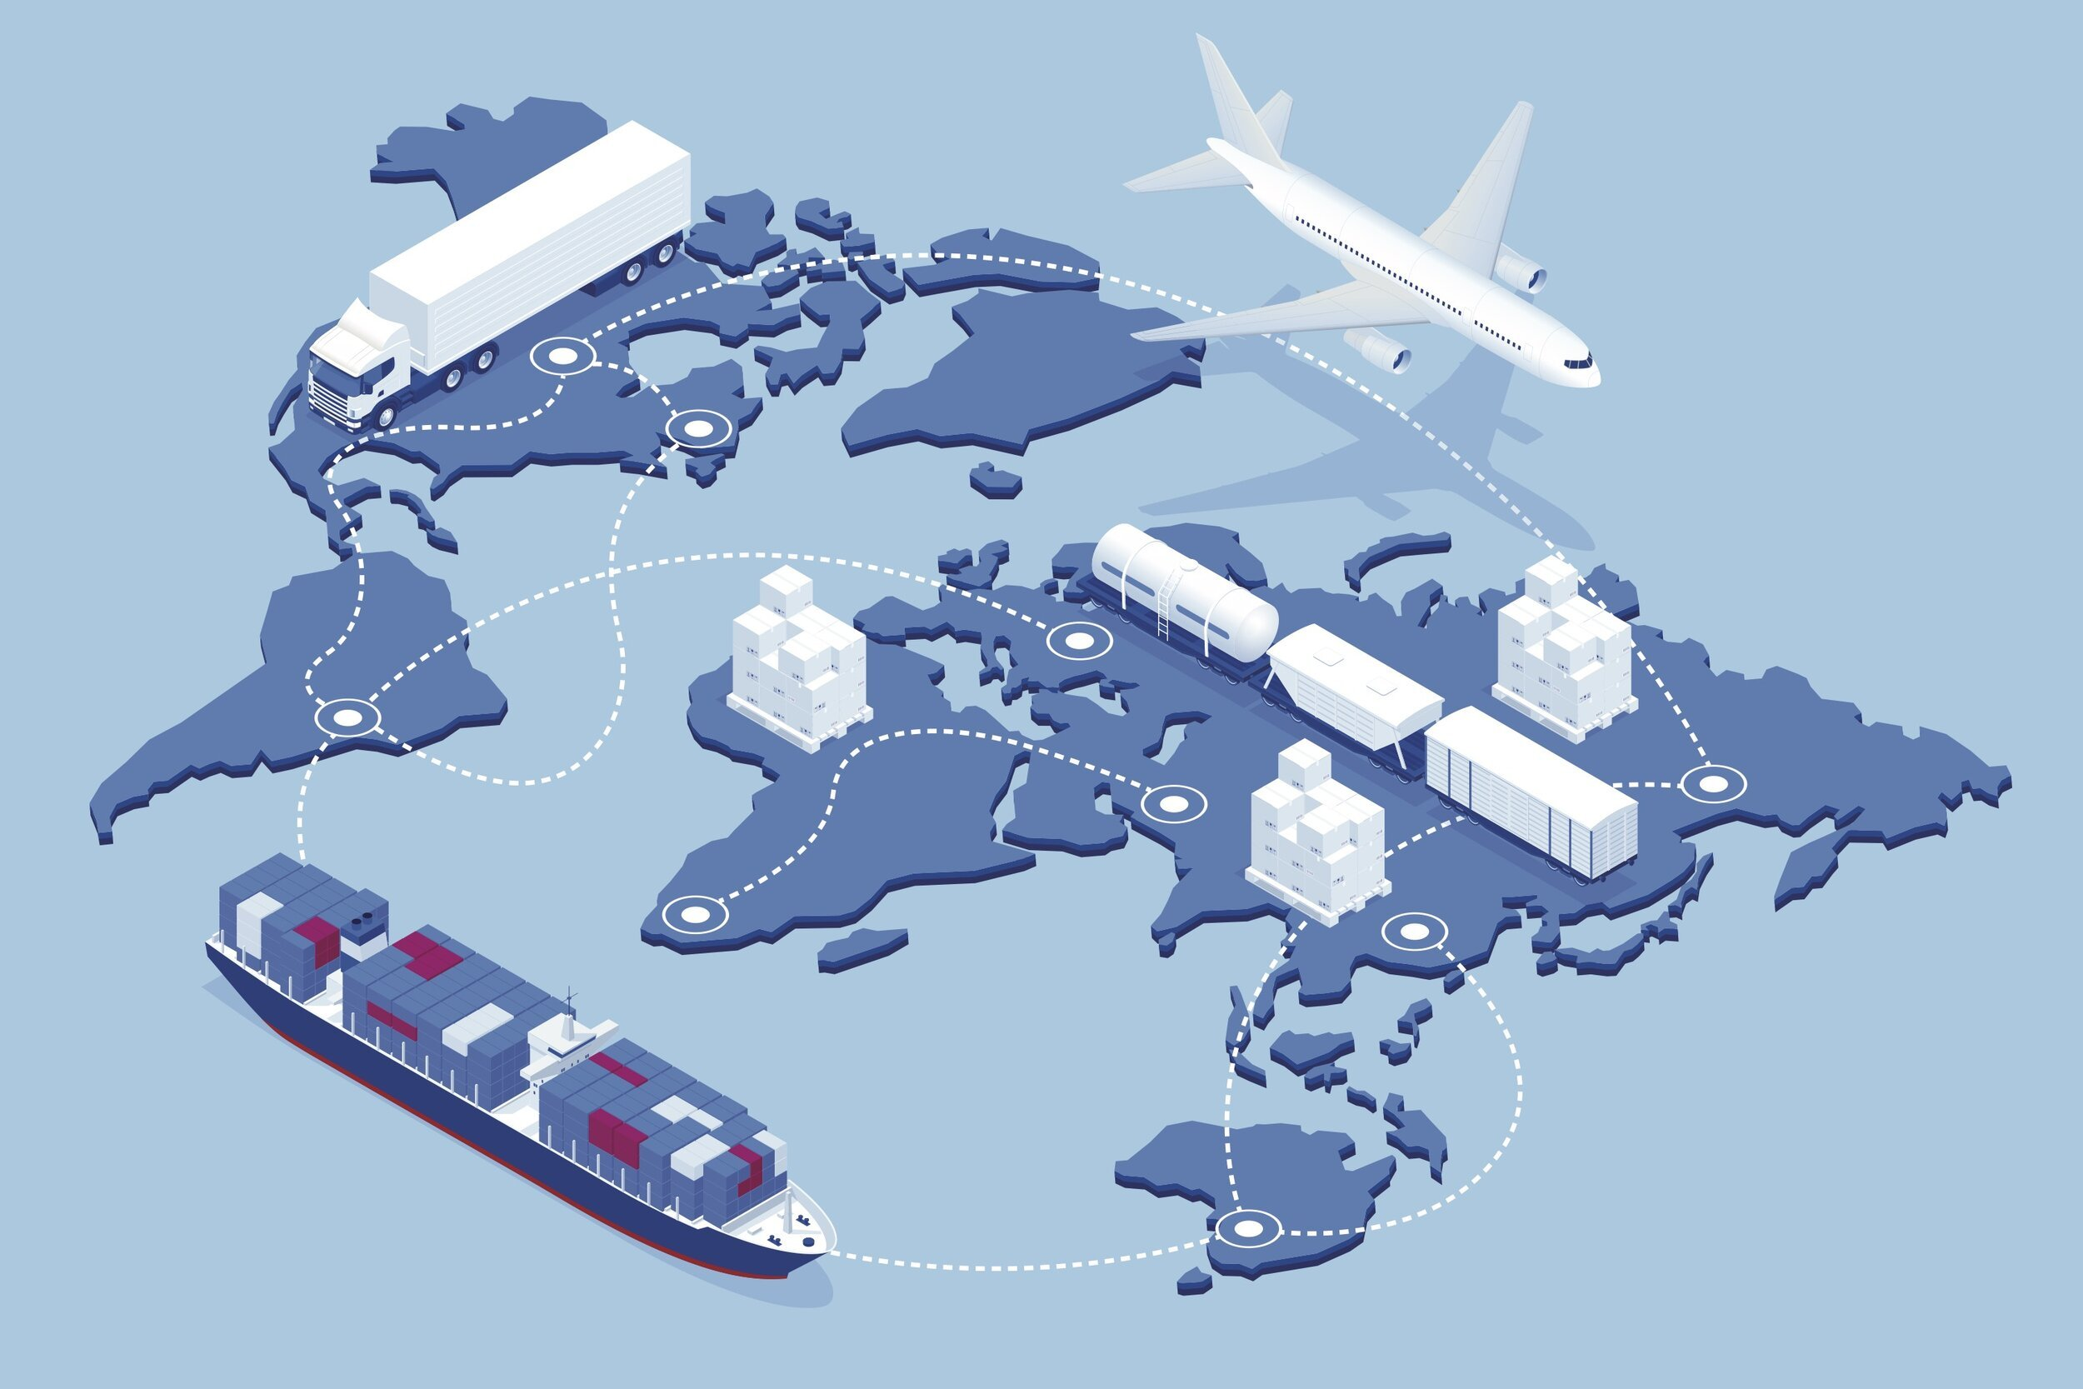
What is the Supply Chain?
Source: https://www.sourcemap.com/blog/what-is-supply-chain-mapping

Slide 5
The Five Major Supply Chain Drivers
1.
Production
What, how, and when to produce
2.
Inventory
How much to make, how much to store
5.
Information
Basis for making these decisions
RESPONSIVENESS versus EFFICIENCY
The right combination of responsiveness and efficiency in each of these drivers allows a supply chain to „increase throughput while simultaneously reducing inventory and operating expense.“
4.
Transportation
How and when to move product
3.
Location
Where best to do what activity
Source: Hugos, Essentials of Supply Chain Management

Slide 6
Global Supply Chain Disruptions – Past 100 Years
2011:
Tohoku Earthquake & Fukushima Disaster
2001:
9/11
Terrorist Attacks
1939-1945:
World War II
1973 & 1979:
Oil Crisis
1929-1939: Great Depression
2018-today: U.S.-China Trade Tensions
1991:
Fall of the Soviet Union
1959:
Suez Canal Crisis
2008:
Global Financial Crisis

Slide 7
Global Supply Chain Disruptions – Past 5 Years
2021: Container Shortage
2020-: COVID-Pandemic
2022:
Russia-Ukraine War
2020:
Brexit
2021:
Suez Canal Blockage
?
2020-:
Global Semiconductor Shortage

Slide 8
Zircoa Survey

Slide 9
Demographic Information

Slide 10
What is the geographic reach of your supply chain?
A high degree of global dependency makes the supply chain vulnerable to external shocks.

Slide 11
What were the biggest supply chain disruptions you faced in the past five years?
Increased costs are a major challenge
Delivery delays are another source of disruption

Slide 12
What is the primary challenge your company faces in achieving a resilient supply chain?
The main obstacles are limited options, high implementation costs, and poor predictability

Slide 13
Which factor is the most important in supply chain management?
The balance between cost and speed with the flexibility to respond to short-term changes is a top priority

Slide 14
What supply chain models do you use?
Strong supplier-customer collaboration - a proven approach to supply chain security

Slide 15
Which of the following trends do you expect will have the most significant impact on supply chains in the investment casting industry?
Lack of consistency and forecast quality is the biggest challenge, followed by raw material shortages and price volatility

Slide 16
What strategies or approaches has your company implemented to improve supply chain resilience?
Supplier diversification and supplier-customer collaboration are top strategies

Slide 17
On a scale 1-10, how satisfied are you with your current supply chain model?
Moderate overall supply chain satisfaction with regional differences
Higher levels of local supply chain elements correlate with higher satisfaction

Slide 18
Zircoa Observations in Best-Practice
Deployment of multiple supply chain methods for critical components
Long-term supply agreement
Concepts for local supply
Flexible transportation
Dual source qualification
Emerging technology and concepts
Adoption of AI
„Never leave a precision caster without a crucible“*
* Richard Funk, retired crucible product manager, Zircoa Inc.
Industry leading manufacturing time
“Revolutionize Delivery“

Slide 19
Key Take-Aways
Challenges: Raw material shortages, transportation disruptions, cost escalation
Geopolitical shifts: Supplier diversification to mitigate risk
Sustainability: Meeting regulatory and consumer demands
Technological Advances: Adoption of AI and data analytics to improve efficiency
Strategy: Proactively adapt to ensure competitiveness and resilience
→ Supply chain agility and collaboration is key to a resilient supply chain

Slide 20

Deliver What Matters

